Slide 1
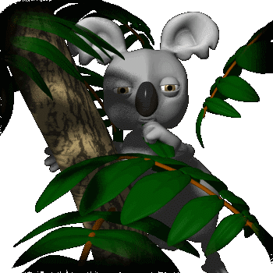
Food chain

Slide 2
Why do we eat food?
Food gives us energy

Slide 3


A hawk gets energy by feeding on small animals
Food chain
A frog gets energy by feeding on bugs and insects.
A plant uses energy from sun to make food.
A grasshopper gets energy by feeding on plants.

Slide 4
What is a Food Chain?
A food chain is the path by which energy passes from one living thing to another.

Slide 5
Words to Know
Producer – A producer is a living thing that makes its own food from sunlight, air and soil. Plants are producers.
Consumers – A consumer is a living thing that cannot make its own food. Consumers get their energy by eating food. All animals are consumers.

Slide 6
In a food chain plants are called as producers
In a food chain animals are called as consumers

Slide 7
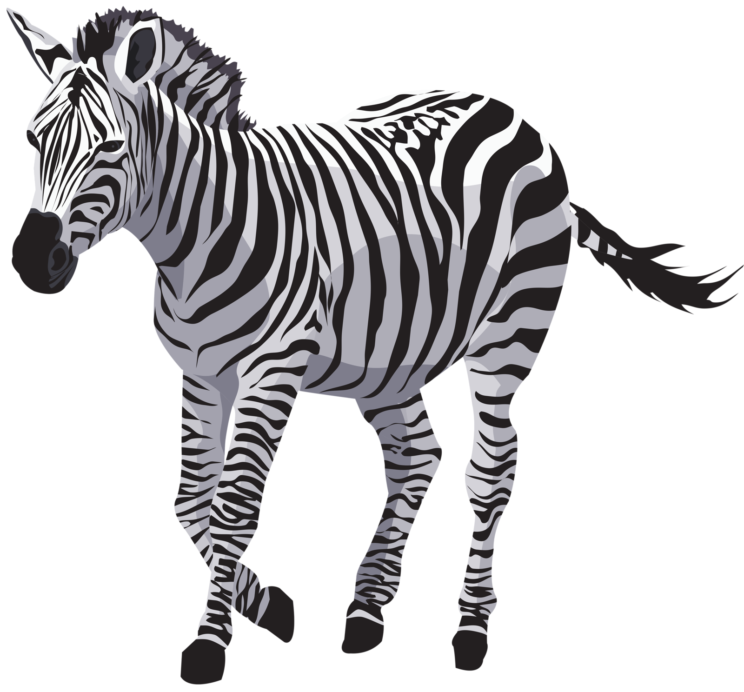
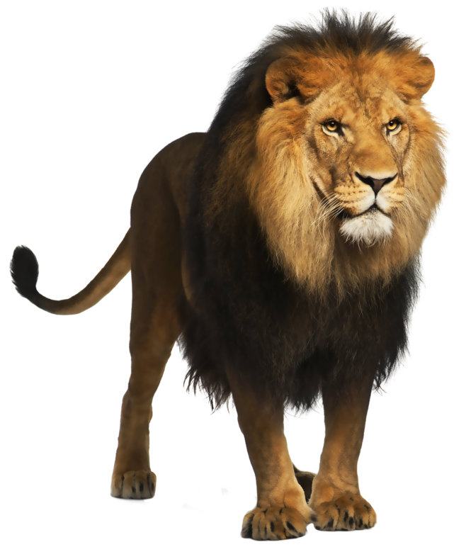
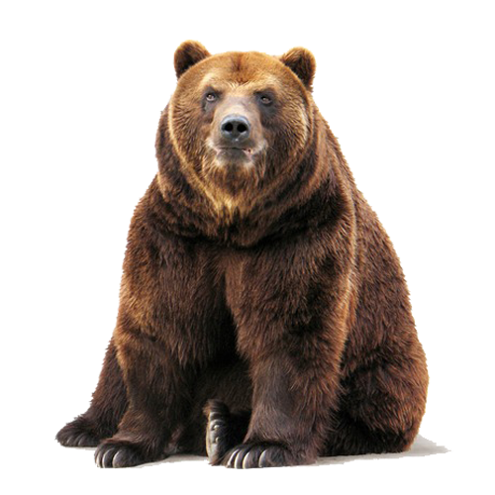
Types of Consumers
Herbivore – A herbivore is a consumer
that eats only plants.
Carnivore – A Carnivore is a consumer
that eats only animals.
Omnivore – An omnivore is a consumer
that eats both plants and animals.

Slide 8
Herbivore
Carnivore

Slide 9
Words to Know
Predator: is an animal that hunts other animals for food
Prey: is an animal that is hunted and eaten for food.
Scavenger: an animal that feeds on the remains of dead animals

Slide 10
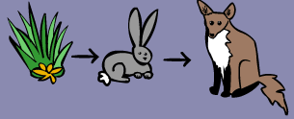
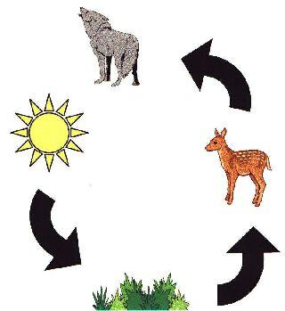
Food Chain
Shows how each living thing gets food
Always begins with the producer
Arrows show the flow of energy from one organism to another

Slide 11

Quiz
A lion is a __________ because it eats only meat.
carnivore
herbivore
omnivore

Slide 12
A _________ is a producer.
cheetah
plant
grasshopper

Slide 13
A seagull lands near an alligator and the alligator eats it. Is alligator a predator or prey?
Predator
Prey

Slide 14

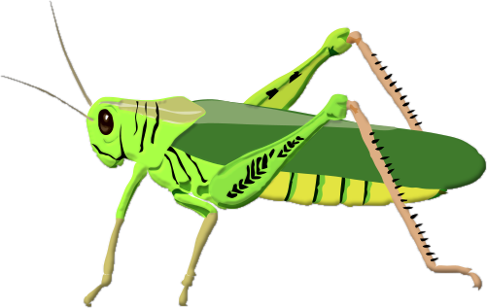
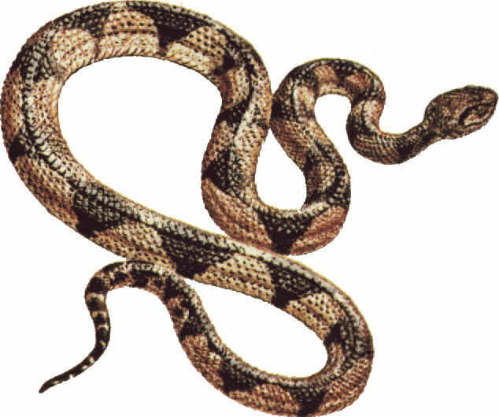
Which animal would fit in the blank of this
food chain?
?
hawk
zebra
mouse
butterfly

Slide 15
5. A penguin is captured and eaten by a leopard seal. Is penguin a predator or prey?
Predator
Prey

Slide 16
Homework
EVS 3A workbook
Complete page 30 and 31

